Slide 1
Apollo Control Box
Goal = Self-contained control box
Focus
Safety: detect all failure scenarios
Ease of use: User experience and maintainability. Large (3.5”) touch screen for diagnostic messages, medical-grade buzzer
Can drive with PSA-based O2 concentrator (Oxikit, PIOC, Apollo reference O2 concentrator)
Open source, modular PCB design. Works with a variety of sensors
Self-tuning AI
learning mode for adjusting valve timing, auto-adjusts to changes in compressed air input pressure
Continuous and pulse mode of operation
Adjust PSA operational cycle in sync with patient breathing
Pulse mode = key to greatly reduces compressor size and power consumption
Patient sensor/data integration
O2 flow regulation: adjust O2 flow in response to oximeter readings
SpO2 oximeter Bluetooth sensors
Breathing rate detection through pressure sensors and flow rate measurement
GTS/Teladoc integration
push medical data to the cloud for doctors to remotely monitor patients)
Integration
Oxikit: proportional valve flow control, GTS/Teladoc integration, Bluetooth oximeter
PIOC, Oxikit: control box
LifeMech – ventilator integration (TBD)
Status
v1..v3 designs published and tested, with Apollo O2 concentrator reference design
Apollo control box: Working on v4 (ETA November/December 2020 for first prototypes)
Pursuing GTS/Teladoc prototyping with Oxikit

Slide 2
PSA/Ventilator integration points
Goal
Unified solution?
Requirements
Breathing rate detection
Ventilator can provide that info
Enables efficient pulse mode operation at PSA concentrator level
Flow regulation
Adjusts O2 concentration dynamically by adjusting PSA timings
Oximeter pulse reading (Bluetooth)
GTS/Teladoc integration
Patient data (SpO2 data)

Slide 3
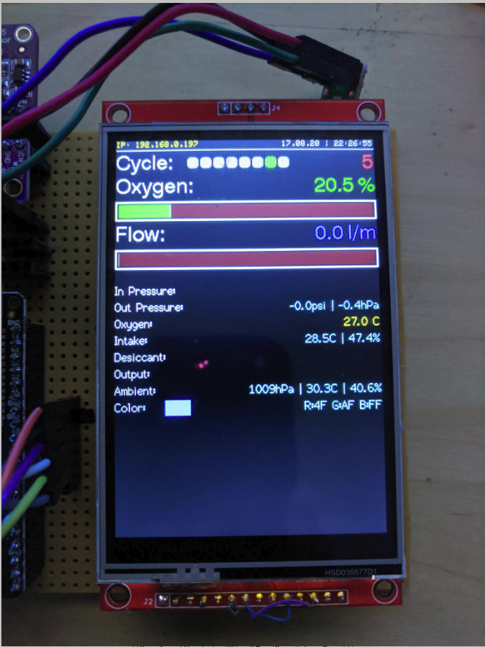
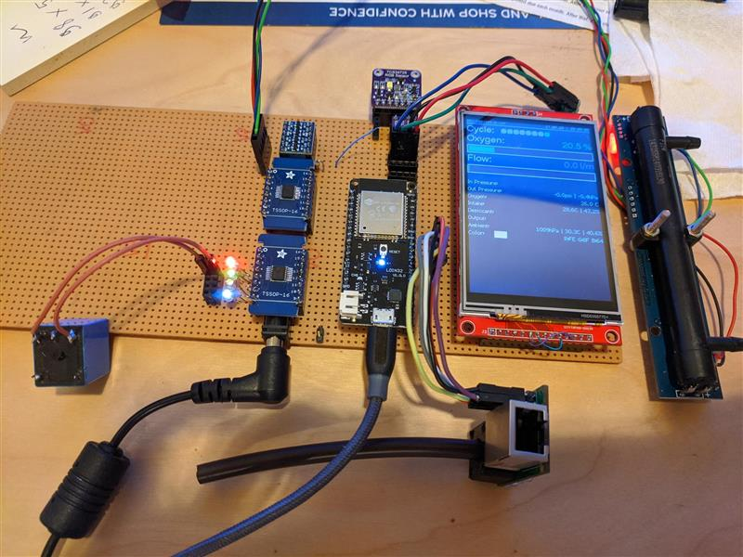
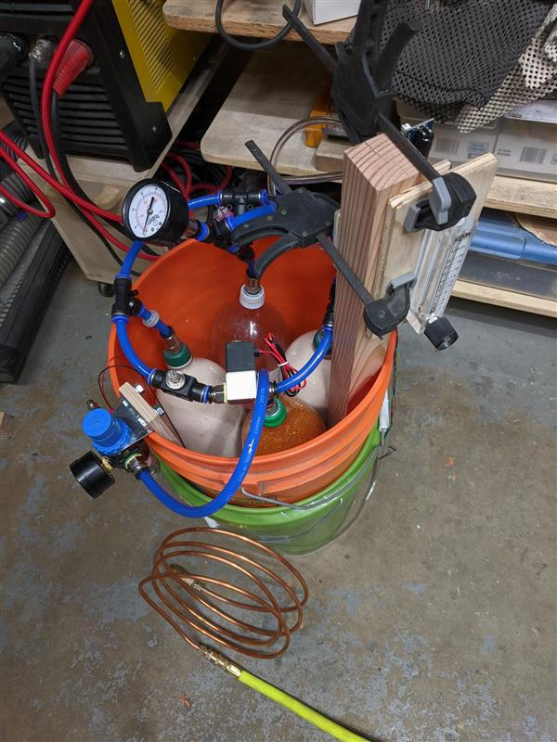
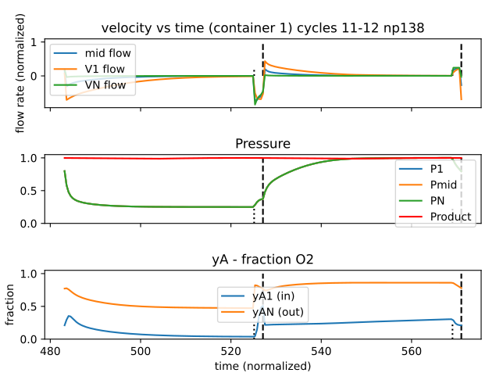
Prototypes

